Slide 1



thynk unlimited
Harnessing
Generative AI for Manufacturing Innovation:
Applications and Opportunities
M11209202 黃雅剖 Huang Ya Pei

Slide 2



07
1. Introduction
2. Literature Review
3. Discussion
thynk unlimited
Evaluation Metrics
We define appropriate metrics to assess the performance of our AI models, such as accuracy, precision, recall, F1 score, and area under the curve (AUC). These metrics help us quantify the effectiveness of our solutions.
www.reallygreatsite.com

Slide 3



02
thynk unlimited
Project Overview
Our Artificial Intelligence project aims to develop advanced algorithms and machine learning models to solve complex problems in various domains. By leveraging AI technologies, we seek to enhance efficiency, accuracy, and decision-making processes.
www.reallygreatsite.com

Slide 4


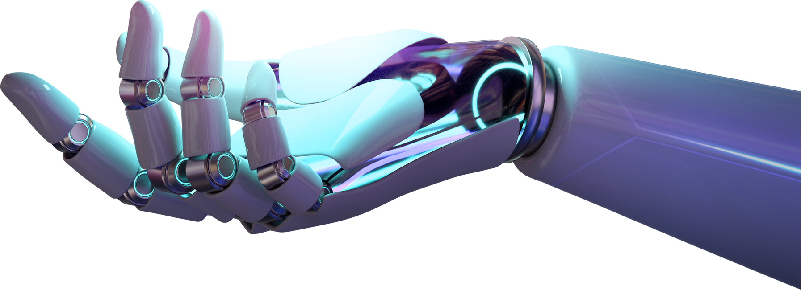
thynk unlimited
Problem Statement
We identify key challenges or opportunities within a specific domain that can benefit from AI solutions. This includes tasks such as predictive analytics, natural language processing, computer vision, and robotics.
03
www.reallygreatsite.com

Slide 5




04
thynk unlimited
Methodology
Data Collection
Preprocessing
Model Selection
Gather relevant data from diverse sources.
Clean, normalize, and engineer data.
Choose and train ML/DL algorithms for peak performance.
www.reallygreatsite.com

Slide 6

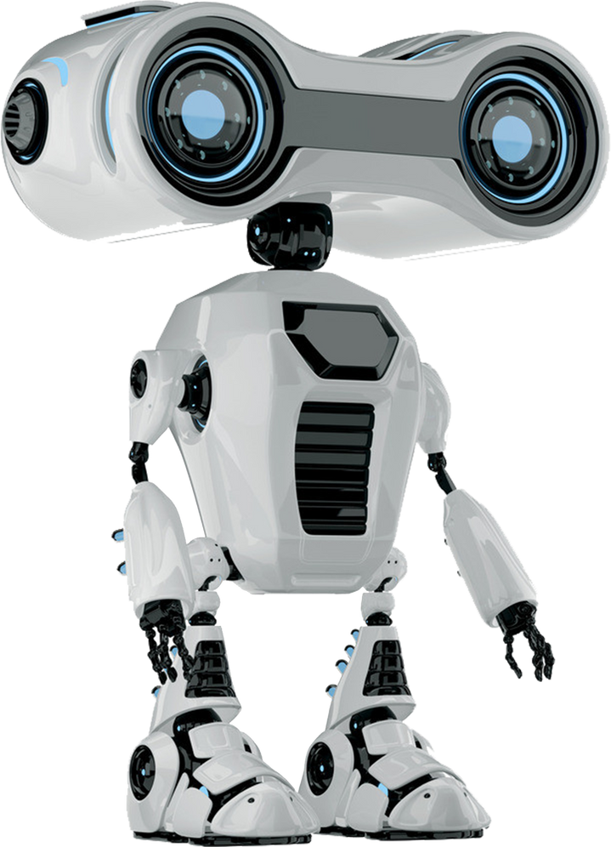
05
thynk unlimited
Data Collection and Preprocessing
We gather relevant datasets from various sources and clean, normalize, and preprocess the data to ensure its quality and consistency. This step is crucial for training accurate and reliable AI models.

Slide 7

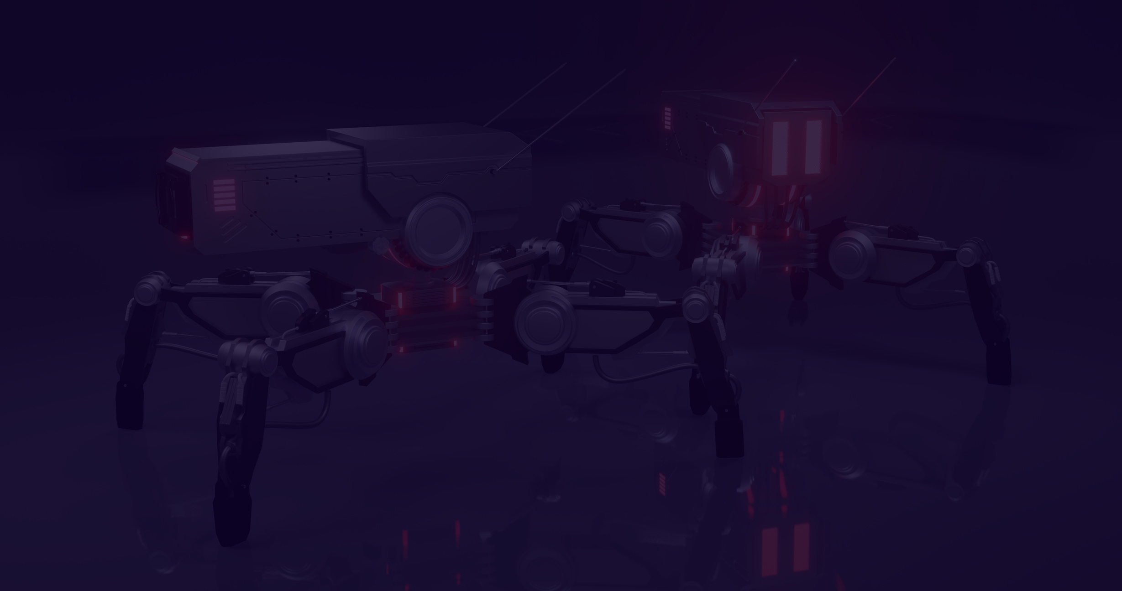

06
thynk unlimited
Model
Development
We design and implement machine learning and deep learning models tailored to the specific requirements of the project. This involves experimenting with different architectures, hyperparameters, and optimization techniques.
www.reallygreatsite.com

Slide 8
07
thynk unlimited
Evaluation Metrics
We define appropriate metrics to assess the performance of our AI models, such as accuracy, precision, recall, F1 score, and area under the curve (AUC). These metrics help us quantify the effectiveness of our solutions.
www.reallygreatsite.com

Slide 9


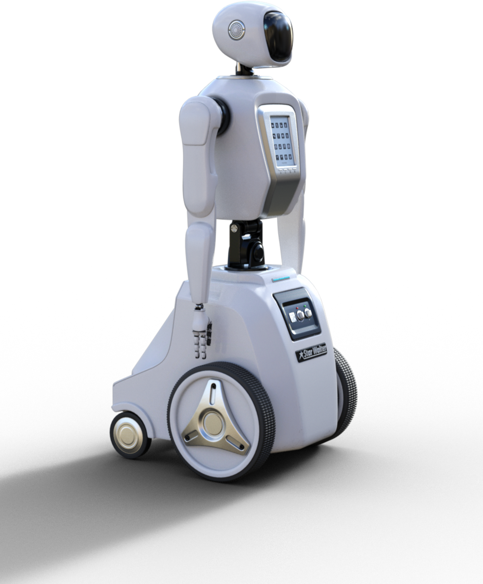
thynk unlimited
Result and Impact
We present the results of our AI project, showcasing improvements in performance, efficiency, and decision-making compared to traditional methods. We also discuss the potential impact of our solutions on stakeholders and end-users.
08
www.reallygreatsite.com

Slide 10


thynk unlimited
Future Directions
We outline future directions for our AI project, including scalability, generalization, integration with existing systems, and exploring new applications and domains. Continuous research and development are essential for staying at the forefront of AI innovation.
www.reallygreatsite.com

Slide 11





thynk unlimited
Thank You!
Get in touch with us
+123-456-7890
www.reallygreatsite.com
hello@reallygreatsite.com

